Slide 1
Indonesia’s Economic Prospects and Challenges: The Role of Private Sector in Achieving Golden Indonesia 2045
2025

Slide 2
Achieving the Golden Indonesia Vision 2045: Indonesia Needs High Economic Growth—The Next 5 to 10 Years Are Key
1998 - 2002:
Indonesia returns to low income due to crisis
2019 – 2020:
Indonesia became an Upper-Middle Income country in 2019 and Returned to Lower-Middle Income due to COVID-19 in 2020
2022:
Indonesia is back in the Upper-Middle Income category
Since 1993: Indonesia exits Low Income
TAHAP 1
TAHAP 2
TAHAP 3
TAHAP 4
Skenario | Average Growth | Year out of MIT
Transformatif | 6% | 2041
Optimistic | 7% | 2038
Indonesia Emas
2045
2025-2029
Strengthening
the Foundation
2030-2034
Acceleration
Transformation
2035-2039
Global Expansion
2040-2045
Golden Indonesia
2045
Sources : RPJMN 2025-2045, BAPPENAS, World Bank

Slide 3
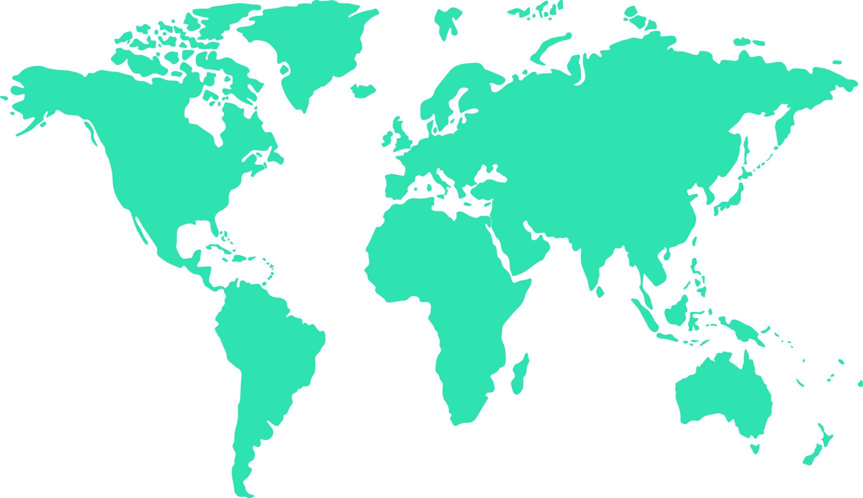
To Achieve Its Economic Growth Target, Indonesia Must Navigate Various Short-Term Global Economic Challenges
The Increasing Intensity of War in the Middle East and Russia-Ukraine.
Trump's 2nd Presidency
China Economic Slowdown vs Stimulus Package
Europe's fragile economic growth
Rising tensions in South and North Korea, China, and Taiwan
Higher for Longer:
Slower Fed Interest Rate Cuts
Sovereign Debt Pressure in Developing Countries

Slide 4
The Impact of Trump's Policies on the Indonesian Economy: Opportunities for Indonesia, Conditional on Capturing Investment Relocations by Improving the Ease of Doing Business
The impact on Indonesia's GDP has the potential to be positive up to +0.8 percentage points
However, on condition that there is an increase in investment (capturing relocation) by improving ease of doing busines
The positive impact could be higher, if exports can be restrained from growing negatively, through diversification of trading partners
Source: McKibbin, Hogan, and Nolan (2024)

Slide 5
At the Same Time, Indonesia is Also Facing Medium-term Challenges
Climate Change - Transition to a Low Carbon Economy
Global Food Security
Digital Disruption and Artificial Intelligence
Geopolitical fragmentation and economic competition

Slide 6
Despite Facing Various Challenges, Indonesia's Economy is Expected to Remain Strong
*2023 GDP Growth

Slide 7
Indonesia Is One of the Less Vulnerable Countries in the World: Low Inflation, Budget Deficit, and Government Debt

Slide 8
Indonesia Will Continue to Implement Fiscal Discipline While Increasing Productive Spending
President-elect Programs Accommodated by the 2025 State Budget
Revenue:
Rp3,005.1 T
Expenditure:
Rp3,621.4 T
-2.5% PDB
Free Nutritious Lunch
Free Health Check
Defisit
Rp616.3 T
Regional
Budget Transfer
Rp919,9
Trillion
Rp71
Trillion
Rp3
Trillion
Grant
Rp0,6
Trillion
Customs & Excise Rp301,6
Trillion
Non State
Budget
Rp1.541,4
Trillion
High Quality Hospital
Renovation
School
Rp2
Trillion
Rp20
Trillion
Non-Tax State Revenue
Rp513,6
Trillion
State Budget
Rp1.160,1
Trillion
Integrated Flagship School
Food Estate
Tax
Rp2.189,3
Trillion
Rp2
Trillion
Rp15
Trillion

Slide 9
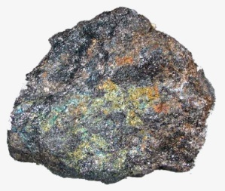
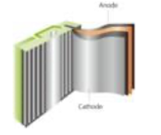
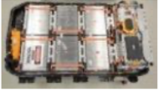
Indonesia Will Continue Economic Transformation by Shifting from Raw Materials to High Value Added Industries
Downstream Program Successfully Changes Indonesia's Economic Structure
No Longer Raw Materials, Nickel Derivative Exports Increase Compared to Previous Year
Nickel sulfate exports in 2023 drive export growth. Exports of nickel derivative products continue to increase amid falling nickel prices
Nickel Ore
MHP, Ni, Co Sulphate
Chemical Components and Battery Cells
Sel, Modul, dan Battery
Electric Vehicles, Power Supply, ESS and Infrastructure
Recycling
Nickel Ore
Nickel and Cobalt Sulphate
Battery Precursor
Cathodes
Battery Cell and Pack
ESS
Charging Station
Battery Recycle
Source: Trademap

Slide 10
Strong Commitment from the President in Reform and Achieving the Vision of Golden Indonesia 2045
Natural Resource Wealth Key to Indonesia's Prosperity
1
Indonesia has natural resources and renewable energy sources to achieve energy and food self-sufficiency. We must be responsible for this gift for the sustainability of the nation.
Reducing Inefficiency in the Economy - High ICOR
2
Indonesia has homework with an ICOR value of 6.6. This ICOR is 30% higher compared to peer countries.
Improving the Quality of Spending
3
High official travel costs: Optimize meetings via online video conferences so that the budget can be optimized to help people in need.
Subsidy Reform
Eradicating Corruption and Online Gambling
4
By being clean and honest, budget leaks can be resolved. Now and in the future, we must end corruption.
Online gambling causes an outflow of US$65 billion
Strengthening Rule of Law
5
Encourage the community and entrepreneurs to fulfill all obligations according to the rules. The government will take strict action against companies that violate
Source: President Prabowo's Speech

Slide 11
Declining Purchasing Power, Especially Among the Lower-Middle Class – Need to Create More Formal Jobs
Income Level
0 – Rp 874 thou / month
> Rp 874 thou –Rp 2,2 mn / month
> Rp 2,2 mn / month
After Pandemic:
9,4 mn
Middle Class
Experiencing Downward Mobility
12,7 mn
Additional Poor and Vulnerable
2014-2019
Pertumbuhan pengeluaran per kapita (%)
2019-2023
Sumber: Dartanto, Susenas

Slide 12
To Grow Higher, Improvement in Economic Efficiency is Needed
ICOR Still High and Fiscal Multiplier Still Low. Estimated to be equivalent to 30% inefficiency or +/- IDR 1000 trillion of total state spending
The fiscal multiplier measures the impact of increased government spending on GDP growth.
Maksimum
1,7
Average
0,5
Indonesia
0,2
0
Source: IMF (2014)
*It takes 6.6% of GDP investment to generate 1% economic growth. The smaller the number, the more efficient.
Minimum
-0,4

Slide 13
Budget Efficiency Measures are Implemented to Improve Spending Quality and Enhance The Multiplier Effect on The Local Economy
More productive spending
Budget Efficiency
More targeted spending
Spending that directly impacts the people, MSME, and local economy

Slide 14
The Role of the Private Sector is Crucial in Driving Economic Growth and Creating Job Opportunities: Government Alone is Not Enough
Contribution to GDP, Based on Institutional Sector
(Percent)
Contribution to Investment, Based on Institutional Sector
(Percent)
Central Gov
Local Gov
SOE
Private

Slide 15
Ease of Doing Business and Business Climate Must Be Improved
Indonesia lags behind in almost all aspects of ease of doing business and investment compared to other ASEAN countries.
Increasing industrial competitiveness is essential to ensure that Indonesia can create jobs. Without increasing competitiveness, industry will move to more competitive countries.
Some examples that obstruct competitiveness: logistics costs, trade policies, worker skills.
Business Bankruptcy
Average Others ASEAN countries
Indonesia
Business Competition
Dispute Resolution
Taxation
International Trade
Financial services
employment
Utility services
business location
start a business
Source : B-ready 2024

Slide 16
Efficiency and Governance Improvements Can Be Accelerated by Continuing the Ongoing Digitalization Program
National Public Service Portal
National Portal for Business Services
National Portal of Government Administration
Digital Community Services Based on Life Cycle
Business Permit Services
Strengthening Governance
Of State Revenue
Strengthening
State Spending Efficiency
National Digital Service
National Dashboard
Effective OSS integrated with Central and Local Government service platforms
Improving the quality of state revenue governance (SIMBARA, Coretax, Palm Oil, etc.)
Streamlining state spending: E-Catalog, and social protection spending (social assistance subsidies)
Community Digital Services (Population, Health, Education)
Institutional Application Services
Social
Protection
Business
Licensing
Tax
public
procurement
State
officials
Healthcare
Education
Non-Tax Revenue
Digital Public Infrastructure
Digital Identity
Digital Payment
Big Data and Artificial Intelligence
Data Exchange
Institution Database

Slide 17
Closing Remarks
To achieve the Vision of Golden Indonesia 2045, Indonesia needs high and inclusive economic growth, and must be able to navigate various challenges, both global and domestic.
Indonesia has basic capital, including maintained economic growth and macroeconomic stability and abundant natural resources and human resources. However, improvements in governance to reduce economic inefficiency and increase added value through sustainable economic transformation must continue to be carried out.
The achievement of the vision of Indonesia Emas 2045 can not be done by Government alone - The role of the private sector is crucial in driving economic growth and creating job opportunities. Greater efforts to undertake structural reforms—deregulation, legal certainty, and policy consistency —must continue.

